Slide 1

Advanced Programming
(C Programming language)
Chapter2-- Variables, Arithmetic Expressions and Input/Output

Slide 2
ºC=(5/9)(ºF-32)
celsius = 5 * (fahr-32) / 9
print Fahrenheit-Celsius table for fahr = 0, 20, ..., 300
0 -17
20 -6
40 4
60 15
80 26
100 37
120 48
140 60
160 71
180 82
200 93
220 104
240 115
260 126
280 137
300 148

Slide 3
#include <stdio.h>
/* print Fahrenheit-Celsius table
for fahr = 0, 20, ..., 300 */
main()
{
int fahr, celsius;
int lower, upper, step;
lower = 0;
/* lower limit of temperature scale */
upper = 300;
/* upper limit */
step = 20; /* step size */
fahr = lower;
while (fahr <= upper) {
celsius = 5 * (fahr-32) / 9;
printf("%d\t%d\n", fahr, celsius);
fahr = fahr + step;
}
}
variables
arithmetic expression

Slide 4
1) VARIABLES
1. Concept
Its value can be changed during program executing
2. Three elements of variables
(1) VARIABLE NAME：keep to rules for identifier
(2) MEMORY UNIT
(3) VALUE
In a program,we can quote variable by variable names
p variable name
variable value
location
Nonce value
3

Slide 5
2.1 Variables: Naming, Declaring,
Assigning and Printing Values
To calculate the area of 10,000 triangles. Given
  lengths of three sides
  three angles
Need to make up your own variable names, e.g.
  lengths: a, b, c
  angles: α, β, γ
For programming in C, the situation is similar
  choose the variable names,
  consist of entire words rather than single characters
  easier to understand your programs if given very descriptive names to each variable. ie Know what you know

Slide 6
2.1 Variables: Naming, Declaring,
Assigning and Printing Values
We may use variable names
  Lengths: length1, length2, length3
  Angles: angle1, angle2, angle3
Much less ambiguous than their algebraic counterparts
Expressions look more cumbersome
  length of expression may span over 1 line
Disadvantage which we simply must live with
Try your best to make the name descriptive – having mnemonic significance

Slide 7
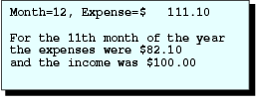
2.1 Variables: Naming, Declaring,
Assigning and Printing Values
int month;
float expense, income;
month = 12;
expense = 111.1;
income = 100.;
printf ("Month=%2d, Expense=$%9.2f\n", month, expense);
Result

Slide 8
2.1 Variables: Naming, Declaring,
Assigning and Printing Values
month = 11;
expense = 82.1;
printf ("For the %2dth month of the year\n"
"the expenses were $%5.2f \n"
"and the income was $%6.2f\n\n", month, expense, income);
Result

Slide 9
Concepts
Variable names must be declared before used
“Declare” all your variable names near the beginning of your program
Variable names are classified as identifiers
  first character must be non-digit characters a–z, A–Z, or _
  other characters must be non-digit characters a–z, A–Z, _, or digit 0–9
Valid examples
  apple1 interest_rate xfloat Income one_two
Invalid
  1apple interest_rate% float In come one.two

Slide 10
Table 2.1
Some Constraints on Identifiers
Comment
ANSI C allows a maximum number of 31 characters for names of internal identifiers
Not allowed; i.e., do not use these words:
auto break case
char const continue
default do double
else enum extern
float for goto
if int long
register return short
signed sizeof static
struct switch typedef
union unsigned void
volatile while
Not allowed, because an identifier is a token
Topic
Maximum number of characters in an internal identifier (i.e., identifier within a function)
Use of C reserved words, also called keywords, as identifier
Use of blank within an identifier

Slide 11
Table 2.1
Some Constraints on Identifiers
Comment
Standard identifiers, such as the function name printf, can be used as variable names. However, their use is not recommended because it leads to confusion.
Allowed; however, many programmers use lowercase
characters for variable names and uppercase for constant names. Differentiate your identifiers by using different characters rather than different cases
Topic
Use of standard identifiers such
as printf
Use of uppercase or mixed-case

Slide 12
DECLARATION AND INITIALIZATION
(1) DECLARATION
form：
< data type> < variable name >[,< variable name2>……];
example：float radius, length, area;
int a,b,c,d;
char ch;
(2) INITIALIZATION
form：
< data type>< variable name >[=<initial value>][,< variable name 2>[=< initial value 2>]……];
example ：float radius=2.5, length, area;
int a=2, b, c=3, d ;
char ch=‘a’;
all variables must be declared
before they are used

Slide 13
3) DATA TYPES
In many applications, programs must be able to store many different types of data. Such as 5, 2.3, ’a’ etc.
Data is the object be processed by algorithm
Data types in C：
integer (int short long)
1.Basic Types
float (double)
character (char)
enum
array
2. Tectonic Types structure
union
3. Pointer
4.NULL
Several types of data are combined together

Slide 14
printf
To display the value of a variable or constant on the screen
printf(format_string,argument_list);
format_string
  plain characters – displayed directly unchanged on the screen, e.g. “This is C”
  conversion specification(s) – used to convert, format and display argument(s) from the argument_list
  escape sequences – control the cursor, for example, the newline ‘\n’
Each argument must have a format specification. For example,
printf("month=%5d \n",month);

Slide 15
There are signed and unsigned forms of all integer types
Storage form and value region
the number of bytes of storage occupied by each type are not same in different system.
In TC is：
int 2bytes
short 2bytes
long 4bytes
Example： i=97
i
0 0 0 0 0 0 0 0 0 1 1 0 0 0 0 1

Slide 16
occupys the number of bytes of storage is n
signed int variable’s value region is：- 2^{n * 8 -1}~（2 ^{n * 8 - 1}-1）
unsigned int variable’s value region is：0 ~（2 ^{n * 8} - 1）
e.g. int variable’s value region is -2¹⁵~（2¹⁵-1），
- 32768~32767；
unsigned int variable’s value region is： 0~（2¹⁶-1），0~65535。
Conclusion:
short [int] 2bytes 0~65535 | -32768~32767
int same as upper
long [int] 4bytes 0~ （2³²-1） | -2³¹~（2³¹-1）

Slide 17
2.2 Arithmetic Operators and Expressions
Consists of a sequence of operand(s) and operator(s) that specify the computation of a value
Look much like algebraic expressions that you write
d = x/y; // x divided by y
Assigns the value of the arithmetic expression(division) on the right to the variable on the left

Slide 18
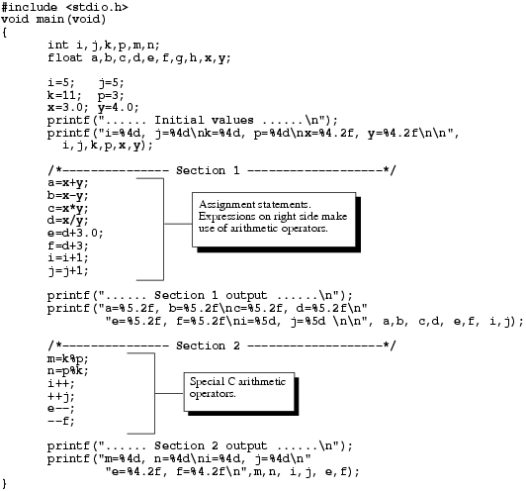
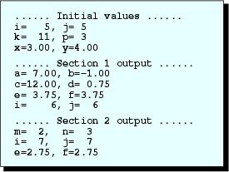
Output

Slide 19
Example 1
int i,j,k,p,m,n;
float a,b,c,d,e,f,g,h,x,y;
i=5; j=5;
k=11; p=3;
x=3.0; y=4.0;
printf("...... Initial values ......\n");
printf("i=%4d, j=%4d\nk=%4d, p=%4d\nx=%4.2f, y=%4.2f\n\n", i,j,k,p,x,y);

Slide 20
Example 1
a=x+y;
b=x-y;
c=x*y;
d=x/y;
e=d+3.0;
f=d+3;
i=i+1;
j=j+1;
printf("...... Section 1 output ......\n");
printf("a=%5.2f, b=%5.2f\nc=%5.2f, d=%5.2f\n"
"e=%5.2f, f=%5.2f\ni=%5d, j=%5d \n\n", a,b, c,d, e,f, i,j);

Slide 21
Example 1
m=k%p;
n=p%k;
i++;
++j;
e--;
--f;
printf("...... Section 2 output ......\n");
printf("m=%4d, n=%4d\ni=%4d, j=%4d\n"
"e=%4.2f, f=%4.2f\n",m,n, i,j, e,f);

Slide 22
C operators can be classified into a number of categories. They include:
  Arithmetic operators.
  Relational operators.
  Logical operators.
  Assignment operators.
  Increment and decrement operators.
  Conditional operators.
  Bitwise operators.
  Special operators.

Slide 23
2 Arithmetic operators
Operator Meaning
  ＋ Addition or unary plus
  － Subtraction or unary minus
  ＊ Multiplication
  ／ Division
  ％ Modulo division
Examples:
  a-b, a+b, a*b, a/b, a%b

Slide 24
Example 1
The Program shows the use of integer arithmetic to convert a given number of days into months and days.
main()
{
int months, days;
printf(“Enter days\n”);
scanf(“%d”, &days);
months = days/30;
days = days % 30;
printf(“Months=%d days=%d”, months, days);
}
Output
Enter days
265
Months=8 Days=25
Enter days
364
Months=12 Days=4
Enter days
45
Months=1 Days=15

Slide 25
3 Relational Operators
C supports six relational operators in all:
Operators Meaning
    < is less than
    <= is less than or equal to
    > is greater than
    >= is greater than or equal to
    == is equal to
    != is not equal to
Example
    4.5<=10 4.5<-10 -35>=0
    10<7+5 a+b=c+d ?

Slide 26
Relational Operator Complements
Among the six relational operators, each one is a complement of another operator.
> is complement of <=
< is complement of >=
== is complement of !=
We can simplify an expression involving the not and the less than operators using the complements as shown below:
Actual one Simplified one
!(x<y) x>=y
!(x>y) x<=y
!(x!=y) x==y
!(x<=y) x>y
!(x>=y) x<y
!(x==y) x!=y

Slide 27
4 Logical Operators
C has the following three logical operators:
  && meaning logical AND
  || meaning logical OR
  ! meaning logical NOT
Example:
i >0 && i<=100
i > j || y >100
num= ! (i>0 && i<100 )

Slide 28
Truth Table
Op_1 Op_2 Value of the Expression
op_1&&op_2 op_1||op_2
Non_zero Non_zero 1 1
Non_zero 0 1 1
0 Non_zero 1 1
0 0 1 1
Examples:
  1. if (age > 55 && salary < 1000)
  2. if (number < 0 || number > 1000)

Slide 29
5 Assignment Operators
C has a set of ‘shorthand’ operators of the form:
v op = exp;
where v is a variable,
exp is an expression
op is a C binary arithmetic operator
op= is known as the shorthand assignment operator
v op =exp; is equivalent to v =v op (exp);
Examples:
x+=y+1; is equivalent to x=x+(y+1);
x+=3; is equivalent to x=x+3;

Slide 30
Shorthand Assignment Operators
Statement with simple Statement with
assignment operator shorthand operator
a = a + 1 a += 1
a = a – 1 a -= 1
a = a * (n+1) a *= n+1
a = a / (n+1) a /= n+1
a = a % b a %= b

Slide 31
The use of shorthand assignment operators has three advantages:
What appears on the left-hand side need not be repeated and therefore it becomes easier to write.
The statement is more concise and easier to read
The statement is more efficient
Example:
value(5*j-2) = value(5*j-2) + delta;
With the help of the += operator, this can be written as follows:
value(5*j-2) += delta;

Slide 32
Example 2
The program prints a sequence of squares of numbers. Note the use of the shorthand operator *=.
#define N 100
#define A 2
main()
{
int a;
a = A;
while(a<N)
{
printf(“Enter days\n”);
a *= a;
}
}
Output
2
4
16

Slide 33
6 Increment and Decrement Operators
see the next page

Slide 34
Rules for ++ and -- Operators
Increment and decrement operators are unary operators and they require variable as their operands.
When postfix ++ (or --) is used with a variable in an expression, the expression is evaluated by using the original value of the variable and then the variable is incremented (or decremented) by one.
When prefix ++ (or --) is used in an expression, the variable is incremented (or decremented) first and then the expression is evaluated using the new value of the variable.
The precedence and associatively of ++ and – operators are the same as those of unary + and unary -.

Slide 35
    自增、自减运算符 ++ --
      作用：使变量值加1或减1
      种类：
        前置 ++i, --i (先执行i+1或i-1，再使用i值）
        后置 i++,i-- (先使用i值,再执行i+1或i-1）
例 j=3; k=++j;
j=3; k=j++;
j=3; printf(“%d”,++j);
j=3; printf(“%d”,j++);
a=3;b=5;c=(++a)*b;
a=3;b=5;c=(a++)*b;
//k=4,j=4
//k=3,j=4
//4
//3
//c=20,a=4
//c=15,a=4

Slide 36
7 Conditional Operator
The form of the conditional expressions:
  exp1 ? exp2 : exp3
  Where exp1, exp2, exp3 are expressions.
The operator ? : works as follows: exp1 is evaluated first. If it is nonzero (true), then the expression exp2 is evaluated and becomes the value of the expression. Note that only one of the expressions ( either exp2 or exp3 ) is evaluated.
Example:
  a = 10; b = 15; x = (a > b) ? a : b;
  if (a > b) x = a; else x = b;

Slide 37
8 Bitwise Operator
C has a distinction of supporting special operators known as bitwise operators for manipulation of data at bit level. These operators are used for testing the bits, or shifting them right or left. Bitwise operators may not applied to float or double.
Operator Meaning
& bitwise AND
| bitwise OR
^ bitwise exclusive OR
<< shift left
>> shift right
int a=139,b=9,c,d,e;
c = a&b; a= 00000000 10001011
d = a | b b= 00000000 00001001
e = a << 3 c= 00000000 00001001
f =b >> 3 d= 00000000 10001011
z= ^c z= 11111111 11110110

Slide 38
9 Special Operators
Pointer Operators:
& and *
Member Selection Operators:
. and ->
int n1=23;
int *p=&n1
printf(“n1=%d,*p=%d”,
n1,*p);
10011011
10100101
01100011
10101010
11111111
00000000
11100011
10100010
????????
????????
????????
????????
????????
????????
地址为1000
1001
1002
1003
1004
1005
1006
1007
n1=23
&n1 ?
地址为1010
1011
1012
1013
1014
p=1000
&n2 ?

Slide 39
The Comma Operator:
can be used to link the related expression together. A comma-linked list of expressions are evaluated left to right and the value of right-most expression is the value of the combined expression.
  Example: value = (x = 10, y = 5, x + y);
  value = 15;
  Some applications of comma operator are:
  In for loops: for ( n = 1, m = 10, n <= m; n++, m++ )
  In while loops: while( c = getchar( ), c != ‘10’ )
  Exchanging values: t = x, x = y, y = t;

Slide 40
The sizeof Operator:
is a compile time operator and, when used with an operand, it returns the number of bytes the operand occupies. The operand may be a variable, a constant or a data type qualifier.
Example:
  m = sizeof (sum);
  n = sizeof (long int);
  k = sizeof(235L);
  Note: The sizeof operator is normally used to determine the lengths of arrays and structures when their sizes are not known to the programmer. It is also used to allocate memory space dynamically to variables during of a program

Slide 41
Example 3
The program employs different kinds of operators. The results of their evaluation are also shown for comparison.
main()
{
int a, b, c, d;
a = 15;
b = 10;
c = ++a – b;
printf(“a=%d b=%d c=%d\n”,a,b,c);
d = b++ +a;
printf(“a=%d b=%d d=%d\n”,a,b,d);
printf(“a/b = %d\n”, a/b);
printf(“a%%b = %d\n”, a%b);
printf(“a*=b = %d\n”, a*=b);
printf(“%d\n”, (c>d)?1:0);
printf(“%d\n”, (c<d)?1:0);
}
Output
a=16 b=10 c=6
a=16 b=11 d=26
a/b = 1
a%b = 5
a*=b =176
0
1

Slide 42


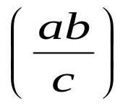

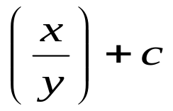
10 Arithmetic Expressions
An arithmetic expression of variables, constants, and operators arranged as per the syntax of the language. The complex mathematical expressions are expressed by C expressions as follows:
Algebraic expression C expression
a * b – c
(m+n) * (x+y)
a * b / c
3 * x * x + 2 * x + 1
x / y + c

Slide 43
11 Evaluation of Expressions
Expressions are evaluated using an assignment statement of the form
  variable = expression; Variable is any C variable name. When the statement is encountered first and the result then replaces the previous value of the variable on the left-hand side. All variables used in the expression must be assigned values before evaluation is attempted.
Example
  x = a * b – c;
  y = b / c * a;
  z = a – b / c + d;

Slide 44
Example 4
Output
x=10.000000
y=7.000000
z=4.000000
The program illustrates the use of variables in expressions and their evaluation.
main()
{
float a, b, c, x, y, z;
a = 9;
b = 12;
c = 3;
x = a – b / 3 + c * 2 - 1;
y = a – b / (3 + c) * (2 - 1);
z = a – (b / (3 + c) * 2) – 1;
printf(“x=%f\n”,x);
printf(“y=%f\n”,y);
printf(“z=%f\n”,z);
}

Slide 45
12 Precedence of Arithmetic Operators
An arithmetic expression without parentheses will be evaluated from left to right using the rules of precedence of operators.
Example
  x = a-b/3+c*2-1
  When a = 9, b = 12, and c = 3
  x = 9-12/3+3*2-1;

Slide 46
Rules for Evaluation of Expression
First, parenthesized sub expression from left to right are evaluated.
If parentheses are nested, the evaluation begins with the innermost sub-expression.
The precedence rule is applied in determining the order of application of operators in evaluation sub-expressions.
The associativity rule is applied when two or more operators of the same precedence level appear in a sub-expression.
Arithmetic expressions are evaluated from left to right using the rules of precedence.
When parentheses are used, the expressions within parentheses assume highest priority.

Slide 47
13 Some Computational Problems
Approximate values for real numbers
  a = 1.0 / 3.0;
  b = a * 3.0;
Division by zero
Avoid overflow or underflow errors

Slide 48
Example 5
The program shows round-off errors that can occur in computation of floating point numbers.
main()
{
float sum, n, term;
int count = 1;
sum = 0;
printf(“Enter value of n\n”);
scanf(“%f”,&n);
term = 1.0/n;
while( count <= n)
{
sum = sum +term;
count++;
}
printf(“Sum = %f\n”, sum);
}
Output
Enter value of n
99
Sum = 1.000001
Enter value of n
143
Sum = 0.999999

Slide 49
14 Type Conversions in Expressions
Implicit Type Conversion
  C permits the mixture of constants and variables of different types in an expression. C automatically converts any intermediate values to the proper type so that the expression could be evaluated without loosing any significance. This automatic conversion is known as implicit type conversion.

Slide 50
int i,x,y;
float f;
double d;
long int l;
x = l / i + i * f - d
long
float
long
float
float
float
double
int
double

Slide 51
Conversion Hierarchy
Note that, C uses the rule that, in all expressions except assignments, any implicit type conversions are made from a lower size type to a higher size type as shown below:
long double
double
Conversion
Hierarchy
float
unsigned long int
long int
unsigned int
int
short
char

Slide 52
Explicit Conversion
The general form of a cast is :
  (type-name) expression
  Where type-name is one of the standard C data types. The expression may be a constant, variable or an expression.
Examples
  x = (int) 7.5
  a = (int) 21.3/(int)4.5
  b = (doublt)sum/n
  y = (int)(a+b)
  z = (int)a+b
  p = cos((double)x)

Slide 53
Example 6
The program shows how to use a cast to evaluate the equation sum = ∑(1/i)
main()
{
float sum;
int n;
sum = 0;
for( n=1; n<=10; ++n)
{
sum = sum +1/(float)n;
printf(“%2d %6.4f\n”, n, sum);
}
}
Output
1 1.0000
2 1.5000
3 1.8333
4 2.0833
5 2.2833
6 2.4500
7 2.5929
8 2.7179
9 2.8290
10 2.9290

Slide 54
15 Operator Precedence and Associativity
Each operator in C has a precedence associated with it. This precedence is used to determine how an expression involving more than one operator is evaluated. There are distinct levels of precedence are evaluated first. The operators of the same precedence are evaluated either from ‘left to right’ or from ‘right to left’, depending on the level. This is known as the associativity property of an operator.
Example:
  x == 10 + 15 && y < 10

Slide 55
Rules of Precedence and Associativity
Precedence rules decides the order in which different operators are applied.
Associativity rule decides the order in which multiple occurrences of the same level operators are applied

Slide 56
Just Remember
Add parentheses () wherever you feel they would help to make the evaluation order clear.将括号（）添加到你觉得这些括号（）有助于明确评估顺序的地方
Be aware of side effects produced by some expressions.
Associativity is applied when more than one operator of the same precedence are used in an expression. Understand which operators associate from right to left and which associate from left to right.

Slide 57
Reading Data from The Keyboard
We can instruct the computer to retrieve data from various input devices
  the keyboard
  a mouse
  the hard disk drive
Programs that have input from the keyboard usually create a dialogue between the program and the user during execution

Slide 58
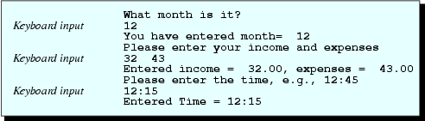
Reading Data from The Keyboard
float income;
double expense;
int month, hour, minute;
printf ("What month is it?\n");
scanf ("%d", &month);
printf ("You have entered month=%5d\n",month);

Slide 59
Reading Data from The Keyboard
printf ("Please enter your income and expenses\n");
scanf ("%f %lf",&income,&expense);
printf ("Entered income=%8.2f, expenses=%8.2lf\n",
income,expense);
printf ("Please enter the time, e.g.,12:45\n");
scanf ("%d : %d",&hour,&minute);
printf ("Entered Time = %2d:%2d\n",hour,minute);

Slide 60
Reading Data from The Keyboard
In order for the user to know what should be done, input prompt to create a dialog is used
Output
dialogue

Slide 61
Reading Data from The Keyboard
scanf() function
scanf (format_string, argument_list);
format_string converts characters in the input into values of a specific type
argument_list contains the address of the variable(s) into which the input data are stored. e.g.
scanf("%f%lf",&income,&expense);
  1st keyboard input data converted to float (%f) => income
  2nd keyboard input converted to double (%lf) => expense

Slide 62
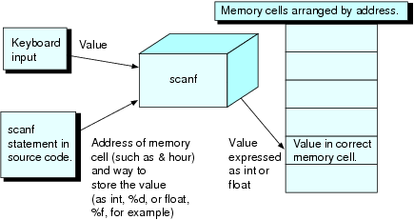
Reading Data from The Keyboard
scanf() function
scanf("%f%lf", &income, &expense);
  &income stands for the address of the memory cell for income
& : “address of” operator
&income - pass the address of variable income to function scanf
By giving scanf the address, the program knows where in memory to put the value typed

Slide 63
Reading Data from The Keyboard
double: C’s floating-point (real) data types
  Occupies twice the memory (8 bytes) of the float type (4 bytes)
  Provide extra precision – increase the range and the number of significant digits
  Computation time increase accordingly, thus you may choose float in case of efficiency concern, i.e.
  float income;

Slide 64
More on Formatting
Using the define directive to define constants
More about conversion specifications and their components
Scientific notation
Flags in conversion specifiers

Slide 65
Preprocessor
To create a constant macro
  use a preprocessor directive
  begin with the symbol # (which must begin the line)
  semicolon must not be used at the end
General form
#define symbolic_name replacement
#define DAYS_IN_YEAR 365
  Draw equivalent of DAYS_IN_YEAR to 365
Prior to translation into machine code, the preprocessor replaces every symbolic_name in the program with the given replacement
printf("Days in year=%5d\n",DAYS_IN_YEAR);
after preprocessing becomes
printf("Days in year=%5d\n",365);

Slide 66
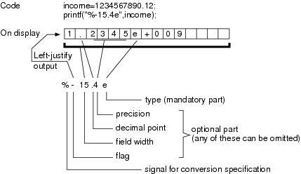
Conversion Specification
Complete structure of format specifications is
%[flag][field width][.precision]type
[ ] are optional

Slide 67
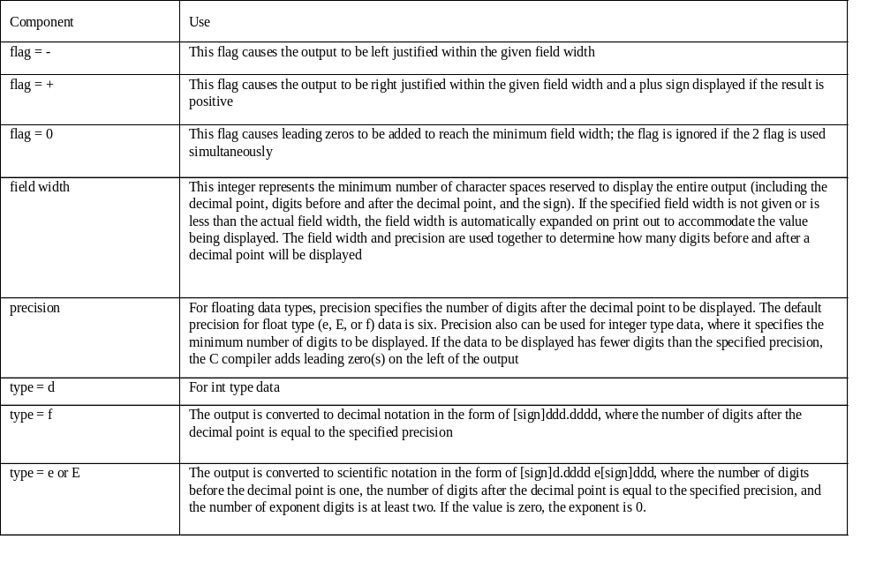
Flags and Types in ANSI C

Slide 68
Conversion Specification
If the precision specified for a real is
  less than actual, displays only the number of digits in the specified precision (trailing digits are not lost from memory, they simply are not displayed)
  greater than actual, adds trailing zeros to make the displayed precision equal to the precision specified
  not specified, makes the precision equal to six
The flag –
  left-justifies a value that is put in a field width that is greater than the actual.

Slide 69

float income = 1234567890.12;
printf ("CONVERSION SPECIFICATIONS FOR INTEGERS \n\n");
printf ("Days in year = \n"
"[[%1d]] \t(field width less than actual)\n"
"[[%9d]] \t(field width greater than actual)\n"
"[[%d]] \t(no field width specified) \n\n\n",
DAYS_IN_YEAR, DAYS_IN_YEAR, DAYS_IN_YEAR);

Slide 70
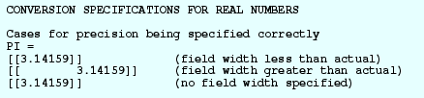
printf ("CONVERSION SPECIFICATIONS FOR REAL NUMBERS\n\n");
printf ("Cases for precision being specified correctly \n");
printf ("PI = \n"
"[[%1.5f]] \t\t(field width less than actual) \n"
"[[%15.5f]] \t(field width greater than actual)\n"
"[[%.5f]] \t\t(no field width specified) \n\n", PI,PI,PI);

Slide 71

printf ("Cases for field width being specified correctly \n");
printf ("PI = \n"
"[[%7.2f]] \t\t(precision less than actual) \n"
"[[%7.8f]] \t\t(precision greater than actual)\n"
"[[%7.f]] \t\t(no precision specified) \n\n",
PI,PI,PI);

Slide 72
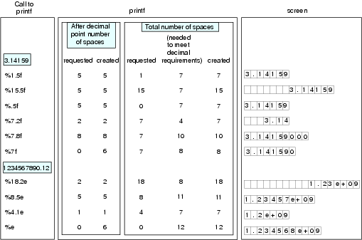
Examples

Slide 73
Conversion Specification
Display int with %f or float with %d?
  likely get nonsensical values or zeros displayed
  common error beginners make
Why was so much attention given to the printf statement?
  will write printf statements very frequently
  can substantially reduce your programming errors

Slide 74
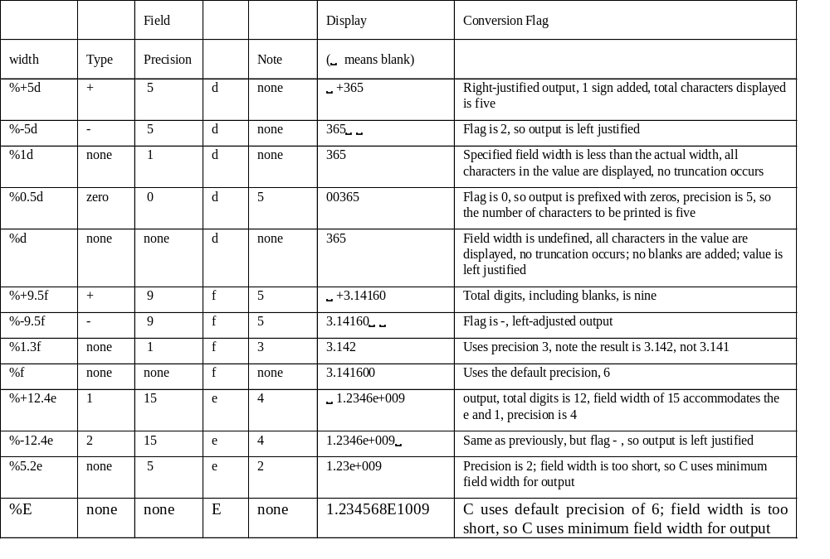

Slide 75
Mixed Type Arithmetic, Compound Assignment
Giving variables their first numerical values is called initialising them, e.g.
x = 5;
Usually complicated expression is placed on RHS
Order of performance of numerical operations can be controlled
Rules about the order of operation of +, -, *, / are established by setting the precedence of the operators
Operators of higher precedence are executed first while those of lower precedence are executed later

Slide 76
Variable Initialisation/Increment Operator
How do we initialise variables?
  Uses an assignment statement, e.g.
  e=3;
  Initialises in a declaration statement, e.g.
  float a=7, b=6;
int i = 1, j =1;
k = i++; h = ++j ?
For 1st expression,
value of i is first assigned to k
i is then incremented (post-increment ++) from 1 to 2
For 2nd one,
value of j is first incremented (pre-increment operator ++) from 1 to 2.
Then the new j value, now equal to 2, is assigned to h

Slide 77
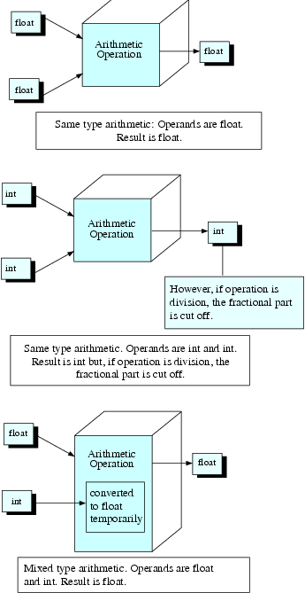
Mixed Data Type Calculation
6.0/4.0 => 1.5
6/4 => 1
6/4.0 => 1.5
  C converts integer to real temporarily and perform the operation

Slide 78
cast Operators
Change the type of an expression temporarily
General form
(type) expression
int aa=5, bb=2;
float xx;
xx = (float) aa / bb;
xx = 2.5, otherwise xx = 2.0
Force a floating
Point division

Slide 79
Operator | Name | No of operands | Position | Associativity | Precedence
( | parentheses | unary | prefix | L to R | 1
) | parentheses | unary | postfix | L to R | 1
+ | positive sign | unary | prefix | R to L | 2
- | negative sign | unary | prefix | R to L | 2
++ | post-increment | unary | postfix | L to R | 2
-- | post-decrement | unary | postfix | L to R | 2
++ | pre-increment | unary | prefix | R to L | 2
-- | pre-decrement | unary | prefix | R to L | 2
+= | addition and assignment | binary | infix | R to L | 2
-= | subtraction and assignment | binary | infix | R to L | 2
*= | multiplication and assignment | binary | infix | R to L | 2
/= | division and assignment | binary | infix | R to L | 2
%= | remainder and assignment | binary | infix | R to L | 2
% | remainder | binary | infix | L to R | 3
* | multiplication | binary | infix | L to R | 3
/ | division | binary | infix | L to R | 3
+ | addition | binary | infix | L to R | 4
- | subtraction | binary | infix | L to R | 4
= | assignment | binary | infix | R to L | 5

Slide 80
Controlling Precedence
Arithmetic operators located within the parentheses() always have highest precedence
Example
z = ((a+b)*c/d);
a+b evaluated first

Slide 81
Associativity
Specifies the direction of evaluation of the operators with the same precedence
First evaluated
1+2 -3
Next evaluated
Direction of evaluation

Slide 82
Side Effect
Primary effect of evaluating an expression is arriving at a value for that expression
Anything else occurs during evaluation of expression is considered a side effect
eg. Assume i=7,
j = i++;
  j=7 is primary effect
  i is changed to 8, is side effect
eg.
j = (i=4) + (k=3)— (m=2);
j = 5 is primary effect (4 + 3 – 2)
Three side effects
  Set i equal to 4
  Set k equal to 3
  Set m equal to 2

Slide 83
Further Exploration
Assign an integer value to a float variable
  convert the result to float and store to variable
  e.g.,
  p = 6 / 4;
  floating variable p will store 1.0
Result of the expression (–6/5)?
  ANSI C standard specifies the result is “implementation defined.”
  compiler has a choice of rounding up or down
  give either –1 or – 2

Slide 84
Dangers of Side Effects
Can be confusing, for example,
k = (k=4) * (j=3);
k will be 12 instead of 4
Best not to use side effects except in their simplest form

Slide 85
Summary
#define symbolic_name replacement
  where symbolic_name occurred throughout the rest of program will be replaced by replacement during compilation by preprocessor
Format specifications
  %[flag][field width][.precision]type
  where format string components enclosed by [ ] are optional
Output of a float number to scientific notation is
  [sign]d.ddd e[sign]ddd
  where d represents a digit

Slide 86
Summary
During mixed mode (different data types) arithmetic, C will automatically convert one of the operands to facilitate calculations
Sometimes type casting can be used to explicitly change data type during calculation
  (type) operand
  where type is the target type being converted into
  operand is the data to be casted

Slide 87
Thank you!
Q & A

